Slide 1
BEGINNER FLL PROGRAMMING WORKSHOP
By DROIDS ROBOTICS & EV3LESSONS

Slide 2
Goals for this workshop
Use sensors to solve FLL missions
Wait For Block with a Sensor
Line Following with Loops & Switches
Learn some tips & tricks in building and programming
Understand where on the Trash Trek Mat you can use these techniques

Slide 3
Where Can I learn more?
During the workshop, we only provided a review of Moving Straight, Turning and Port View. If you want to learn more, please visit EV3Lessons.com – Beginner.
We only provided a quick introduction to Loops and Switches during the Line Following lesson. For fun challenges and to learn more, please view the Beginner lessons on Display Blocks, Loops and Switches.

Slide 4
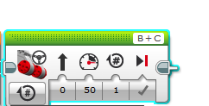
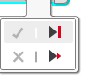
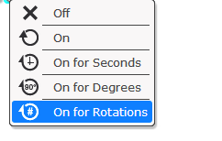
Review: MOVING STRAIGHT
Move Steering Block
B
C
Mode of operation
Brake/Coast
Steering: Straight or turn
Power/Speed
Duration/Distance

Slide 5
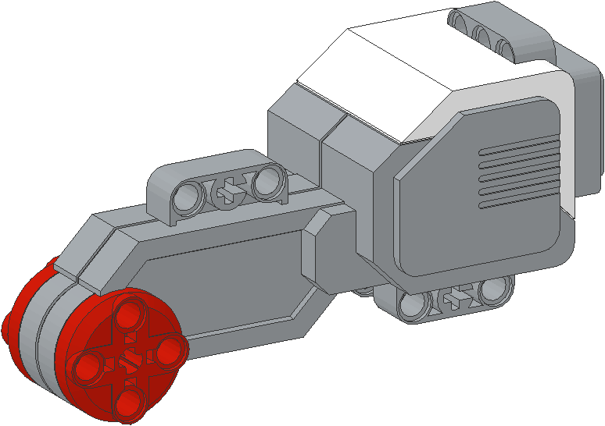
NEGATIVE & POSITIVE POWER: BACKWARD & FORWARD
Negative Power = Backwards
Positive Power = Forward

Slide 6
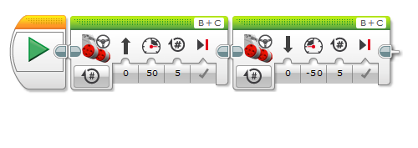
REVIEW: Moving Forward and Backwards
This would be changed for degrees or seconds

Slide 7
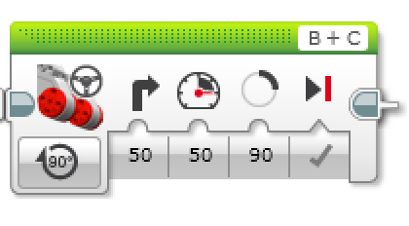
Review: PIVOT & SPIN TURNS
Different Turns and Different Steering Values
50 | -50 | 100 | -100
Pivot Turn Right | Pivot Turn Left | Spin Turn Right | Spin Turn Left
More accurate, but takes more space |  | Good for tight spaces, faster, less accurate
B
B
B
B
C
C
C
C
Change Steering value
Move Steering Block

Slide 8
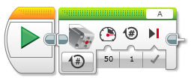
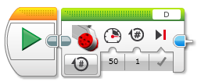
REVIEW: Using ATTACHMENTS
Attach a medium motor to Port A or a large motor to Port D as needed.
Move Steering vs. Motor Block
For moving your wheels you should use a Move Steering Block that syncs both wheel motors (see intermediate lesson called Move Blocks to learn about sync)
For moving your attachment your arm, you use either a Medium Motor Block or a Large Motor Block because you don’t need to sync your motors.
Medium Motor Block
Large Motor Block

Slide 9
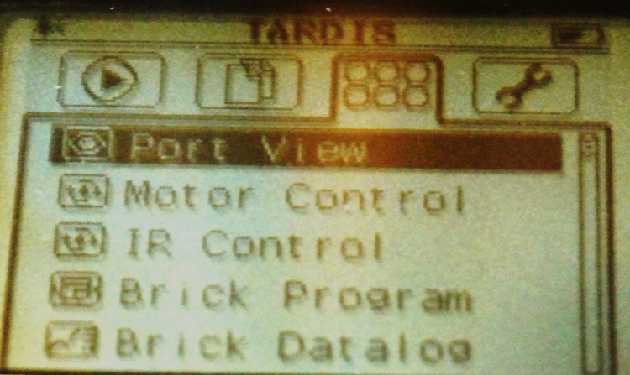
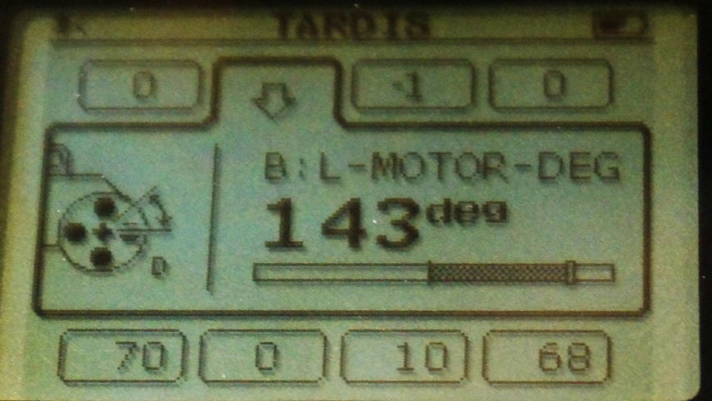
USEFUL TIP: Port View
Rookie Tip: Use Port View on your brick to read sensor values, and measure distances

Slide 10
Why use Sensors in FLL?
Sensors can help you know your position on the FLL table
Sensors can help you be more accurate therefore receiving less touch penalties
Sensors can help you do accurate turns, straighten up on lines, move until a certain distance from a wall, and know when you are on a wall
Moving up to a mission model accurately might need a sensor

Slide 11
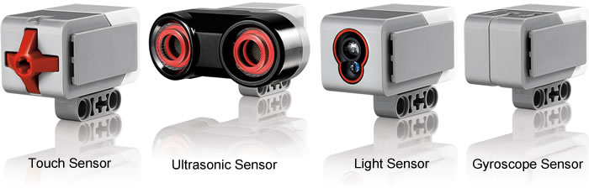
What is a sensor?
A sensor lets an EV3 program measure and collect data about is surroundings
The EV3 sensors for FLL include:
Color – measures color and darkness
Gyro – measures rotation of robot
Ultrasonic – measures distance to nearby surfaces
Touch – measures contact with surface
Image from: http://www.ucalgary.ca/IOSTEM/files/IOSTEM/media_crop/44/public/sensors.jpg

Slide 12
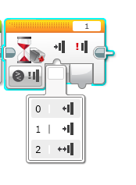
WHAT IS A TOUCH SENSOR?
Touch Sensor can detect when the sensor’s red button has been pressed or released
With this information, you can program an action when the sensor is:
Currently Pressed
Currently Released
Bumped

Slide 13
When might you use this sensor IN FLL?
Useful for programming “moving until touch sensor is pressed/released”
For example, if you put a touch sensor on the front the robot, you can have it stop moving if it runs into something.
You can also have your program start or stop when a touch sensor is pressed.

Slide 14
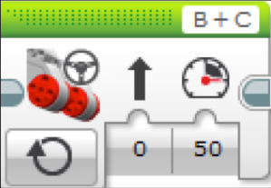
Move on and OFF
What would happen if you placed a Move Steering Block and left the motor “On”?
Would the robot…
1) Move?
2) Move for a little while?
3) Not move at all?
ANS.
What does Motor Off do?
Rookie Tip: Motor On needs to be followed by another block (e.g. Wait Block)

Slide 15
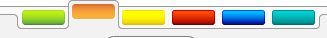
HOW Do you program with the Touch Sensor?
Wait For Block
Orange Flow Tab: Wait for Block
Used to wait for a sensor reading (or time)

Slide 16
CHALLENGE
Program your robot to move until it hits the edge of a wall. Then back up and turn right 90 degrees.
0 = released
1 = pressed
2 = bumped
B
C
Hint: You will combine Move Steering + Turning + Wait Block

Slide 17
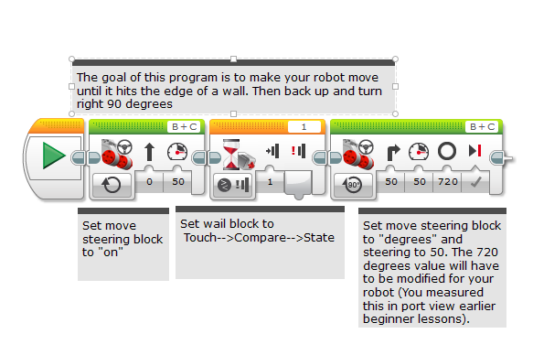
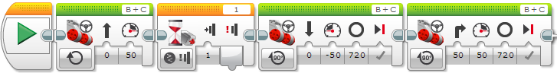
Challenge Solution

Slide 18
HOW DO YOU Program with the Ultrasonic?
Very similar to the touch sensor
Just change the wait for block to wait for a reading from the ultrasonic sensor
Use it to stay a particular distance away from the wall or mission model.

Slide 19
What is the color sensor?
What are they? Sensors that detect the intensity of light that enters it
Three modes: Color, Reflected Light Intensity and Ambient Light Intensity
Color Mode: Recognizes 7 colors (black, brown, blue, green, yellow, red, white) and No Color
Reflected Light: Measures the intensity of the light reflected back from a lamp that emits a red light. (0=very dark and 100=very light)
Ambient Light: Measures the strength of the light that enters the sensor from the environment. (0=very dark and 100=very light)

Slide 20
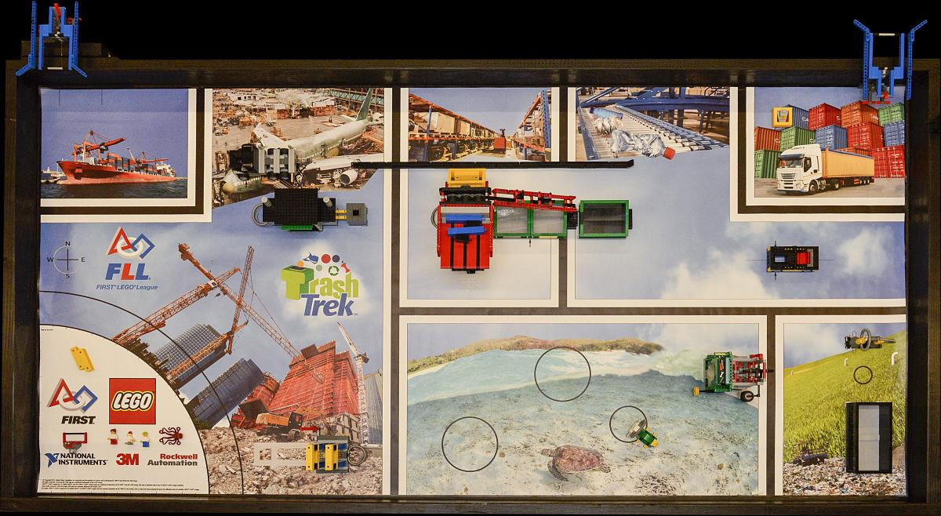
Why use a Color Sensor in FLL?
FLL mats have many lines that you can use to make your robot more reliable
Use the color sensor to move until a line, follow a line, and square up on a line
We will teach you to move until a line and follow a line in this workshop. The other square up on a line lesson is available on EV3Lessons.com

Slide 21
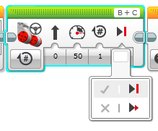
ANOTHER MOVE STEERING TIP: COAST or Brake?
Something more about the Move Steering Block
You will notice you have an option to COAST or BRAKE
Coast will make the motors keep moving. Brake makes the motors stop immediately.
Which do you use to stop EXACTLY on a colored line?

Slide 22
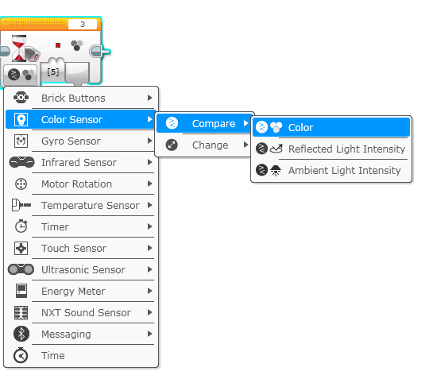
COLOR SENSOR CHALLENGE
Make the robot move up to a black line using the color sensor?
Step 1: Use Wait For Color
Step 2: Use the color sensor in COLOR MODE
Step 3: Coast or Brake?
Hint: You will use Move Steering (think about motor on and off) and Wait for “Color”

Slide 23
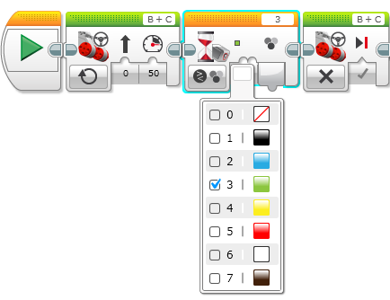
Color Sensor Challenge Solution
FINISH
Move Steering
Set to “ON”
Move Steering
Set to “OFF” with BRAKE
START
Wait until Color is Black (#1)

Slide 24


BEGINNER PROGRAMMING Lesson
Basic Line Follower
By: Droids Robotics

Slide 25
Where line following could be useful in FLL
Trash Trek mat is covered with black lines
Lines go up to useful regions
Lines go up to mission models

Slide 26
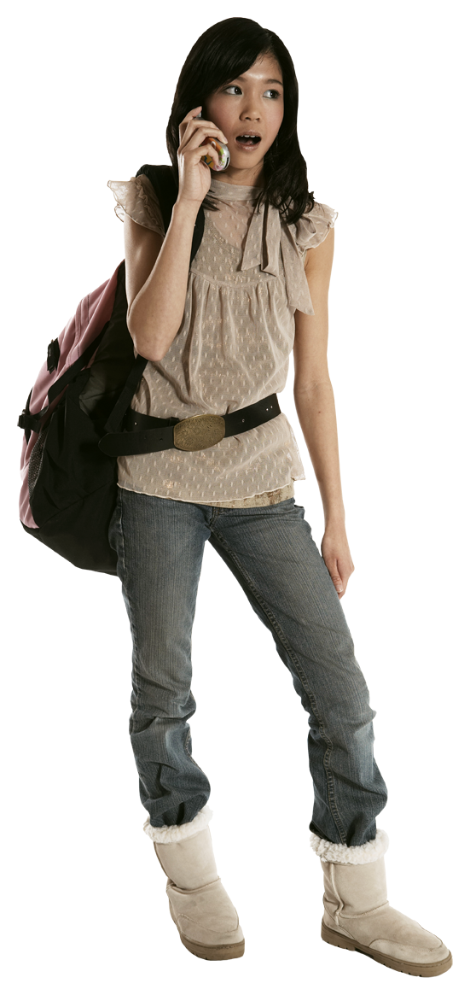
FOLLOW THE MIDDLE?
Humans want to follow the line in the middle.
Let’s have the robot do the same thing using the Color Sensor
What type of questions can we ask using this sensor
Are you on line or not?

Slide 27
If we are on black, keep going straight
If we are on white, turn left to get back to the line
Seems to work fine here…

Slide 28
If we are on black, keep going straight
If we are on white, turn left to get back to the line
OH NO… my robot is running away….
When the robot leaves the left side of the line, the program no longer works!

Slide 29
Line Following: ROBOT STYLE
Why could the Human follow the middle?:
They can see ahead.
They can see the whole line and its surroundings
They see both sides and which side they left
Why can’t the Robot do the same thing?:
Can’t tell right or left side of the line
How do we make sure the robot always veers off on the SAME SIDE of the line?
Instead of the middle, could the robot follow the “edge”?
So now the robot will fall off only the same side.
We will now show you how this works!

Slide 30
ROBOT LINE FOLLOWING Happens on the edges
Left side line following
Right side line following
If on black, turn left.
If on white turn right.
If on black, turn right.
If on white turn left.
The robot has to choose which way to turn when the color sensor sees a different color.
The answer depends on what side of the line you are following!

Slide 31
starting the roboT on the correct side
✗
✔
✔

Slide 32
How do you write a line follower?
First, the robot will have to decide between 2 actions. What are the two actions?
ANS:
Second, the robot is repeating an action over and over again. What action does the robot repeat again and again?
ANS:

Slide 33
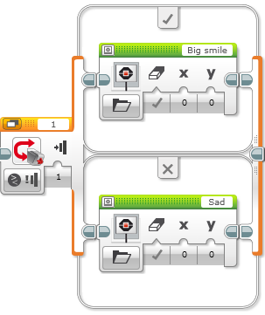
Switch Blocks
Run this code if the answer is yes
Asking the robot a question and doing something different based on the answer
Example: Does the robot see a line? Or not?
Basically a YES/NO QUESTION
Switch blocks are found in the orange/flow tab
The question being asked: is the touch sensor pressed
Run this code if the answer is no

Slide 34
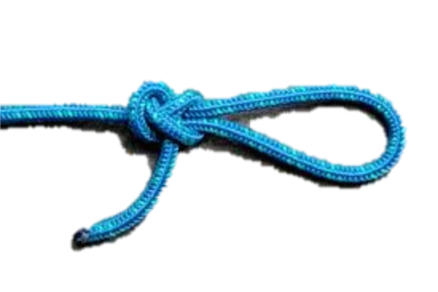
Loops
Loops make repeating a task multiple times easy
KEEP GOING….Forever, for a Count, Until touch (or something else)

Slide 35
Line Follower challenge 1
Step 1: Write a program that follows the RIGHT edge of a line.
Hints: If your sensor sees black, turn right. If your sensor sees white, turn left. Use loops and switches!
B
B
C
C

Slide 36
Other things to try
Try the line follower on different lines.
Can you write a smoother line follower (less wiggle)?
Can you have your robot line follow for a particular distance? (Hint: Use Port View to measure the distance)
Can you have your robot line follow until it finds an intersection? (Hint: Use the second color sensor)

Slide 37
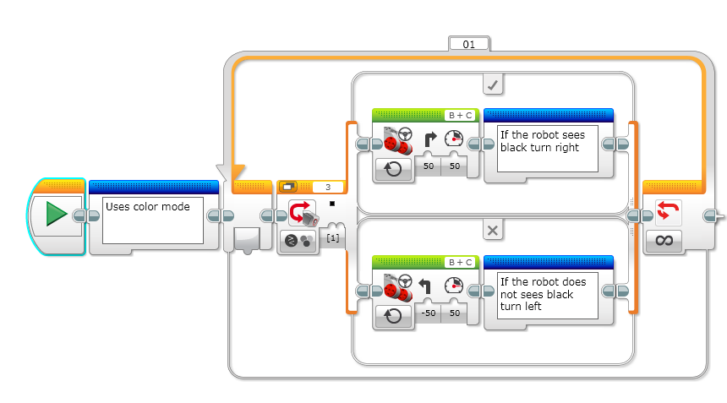
LINE FOLLOWING CHALLENGE SOLUTION
Q. Does this program follow the Right or Left side of a line?
A. The robot is following the Right Side of the line.
Notes:
Right side

Slide 38
CHALLENGE 1 SOLUTION
Q. This line follower goes forever. How do we make this stop?
A. Change the end condition on the loop.
Notes:
Right side

Slide 39
Line follower challenge 2
Part 1: Make a line follower that stops when you press the touch sensor
Part 2: Make a line follower that stops after it travels a particular distance
Hint: You will have to use PORT VIEW in your brick to measure the distance first

Slide 40
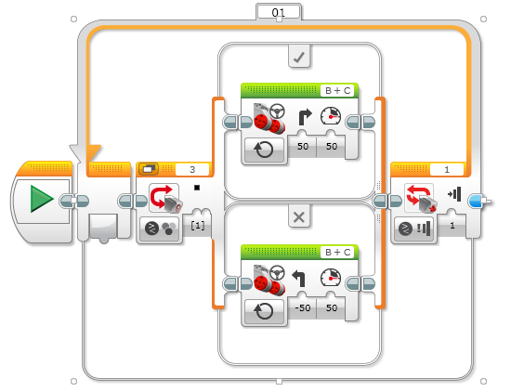
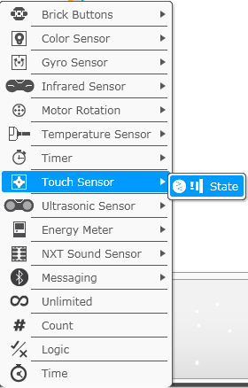
Challenge 2 SOLUTION: SEnsor

Slide 41
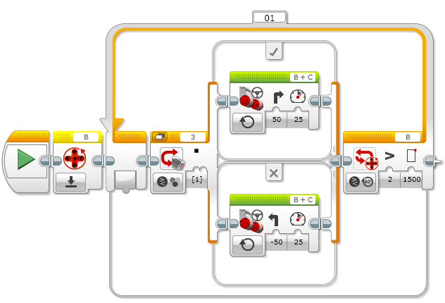
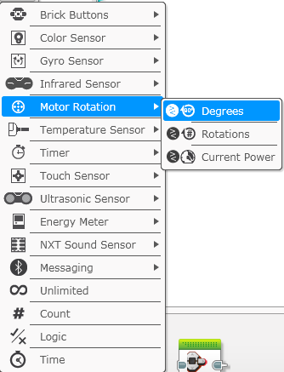
Challenge 2 SOLUTION: PARTICULAR distance

